Slide 1
EGCI 491 Computer Engineering Project Seminar
Pipatphon Lapamonpinyo, Ph.D.
e-mail: pipatphon.lap@mahidol.edu
Office Hours: Open door policy and by appointment (Fri 10:00-11:30, Building#2 R234)
Faculty of Engineering, Mahidol University

Slide 2
Outline
Sources of reference/information of how to write a thesis/academic journal
Essential concepts of how to write a good thesis/research paper
Structure & Contents
CH1: Introduction
CH2: Literature Review
CH3: Methods
Ch4: Results
CH5: Discussion, Conclusion, Future Work

Slide 3

How to write a good proposal
Sources of information
492 Class: https://sites.google.com/site/egci492/thesiswriting?authuser=0
Harvard University*: https://www.google.com/url?sa=t&rct=j&q=&esrc=s&source=web&cd=&cad=rja&uact=8&ved=2ahUKEwi-n6rMxriBAxVbzjgGHdHjDW4QFnoECBEQAQ&url=https%3A%2F%2Fseas.harvard.edu%2Fmedia%2F79531%2Fdownload&usg=AOvVaw3Z93viW4FUHnXwXdSFvCF0&opi=89978449
IEEE Journal Guideline: https://journals.ieeeauthorcenter.ieee.org/create-your-ieee-journal-article/create-the-text-of-your-article/structure-your-article/
UC Berkeley: https://publichealth.berkeley.edu/wp-content/uploads/2020/08/Honors-Thesis-Guide-2020.pdf
Penn State University VDO Clips: http://www.writing.engr.psu.edu/workbooks/theses.html
Boston University: https://www.bu.edu/com/files/2019/11/ems_guidelines_for_thesis_proposal.pdf

Slide 4
Introduction
Thesis is written in the format of a research paper :
1) Introduction
2) Literature Review
3) Methods
4) Results
Tables and Figures
5) Discussion & Conclusion
Future Work
Abstract
Must have -> Keywords (~ 5 words)
References
Note:
Plagiarism (copying text or figures from any source without any citations) is unacceptable.

Slide 5
Suggested Orders to write your thesis/proposal
Select A Main Advisor & Title (2 points, Week#3)
CH1: Introduction
Clear Objectives
Scope
Methods & Data
Expected Results
Performance Evaluations
Timeline
CH2: Literature Review -> Related Previous Work!
Only published academic papers* are accepted
Each member presents at least 1 paper (3 points, Week#6)
Research Problems/Gaps
Main Contributions
Methods and Data
Evaluation Approaches (to evaluate accuracy e.g., R2, F1, MSE, MAE, etc.)
Key Findings (in Abstract, Discussion, and Conclusion )
CH3: Methods -> What you propose!
System Design/ Diagrams
Flowcharts/ Workflow
CE Technical Methods (e.g., ML techniques)
CH4. Results
Figures/Tables
Point out/explain what you like to explain about your results/experiment
CH5 Discussion & Conclusion
Interpret your results
How your results support/go against your research questions/hypothesis
Revisit figures/tables
Abstract
Others:
Covers
Bibliography/ References
Appendix

Slide 6
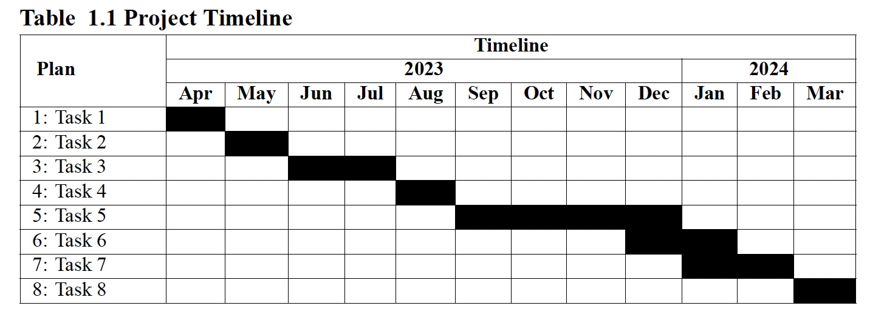
1) CH1: Introduction
Week#3: 2.0 Title & A Main Advisor
Week#4: PR#1.1: (2.2, 2.3)
Week#5: PR#1.2: (CH1-Draft + 2.1 - 2.5)
2.0 Title (Week#3, 2 points)
2.1 Background
2.2 Objective
Must use action verbs
To develop …
To identify …
To increase/reduce …
2.3 Scope
What you do/do not consider
What you can’t do and exclude from the project
Limitations
Ranges of data/date/time
Platforms/Devices
2.4 Expected Results Expected Outcomes:
The proposed system/algorithm can …
The accuracy increases/reduces … %
The XXX can identify/solve …
2.5 Timeline

Slide 7
1) CH1: Introduction
Tips:
A very good introduction can only be written when you have a strong understanding of the existing research.
2.1 Background precisely tell the readers:
Why your project/research is important
Essential Background Information of your project/research topic
What is the problem that you are trying to address?
Point out the reasons why your work is crucial
Why it does matter
What is already known about your topic
A completed outline of your literature review in brief.
(all related previous works with appropriate citations/references)
What are the gaps that your project/research/study/ addresses
Only focus on the gaps that your work can address.
End this part with your Research Questions / Contributions/ Objectives

Slide 8
2) CH2: Literature Review
Helpful Resources:
Missy Harvey, “What Is a Literature Review?”, Carnegie Mellon University, 2010. https://www.andrew.cmu.edu/user/matthewm/What_is_a_Literature_Review.pdf
What can a literature review do for me? How to research, write, and survive a literature review (Stanford University). Available at: https://nursing.fau.edu/documents/LiteratureReviewHandout.pdf
Writing literature reviews (George Washington University). Available at: https://www.google.com/url?sa=t&source=web&rct=j&opi=89978449&url=https://www.cs.cmu.edu/~missy/WritingaLiteratureReview.doc&ved=2ahUKEwi8jODhneGIAxUx2DgGHZoWE5UQFnoECCoQAQ&usg=AOvVaw3JrMx0477zRqx7weStuv4r
The Literature review: A few tips on conducting it (University of Toronto). Available at: https://advice.writing.utoronto.ca/types-of-writing/literature-review/

Slide 9
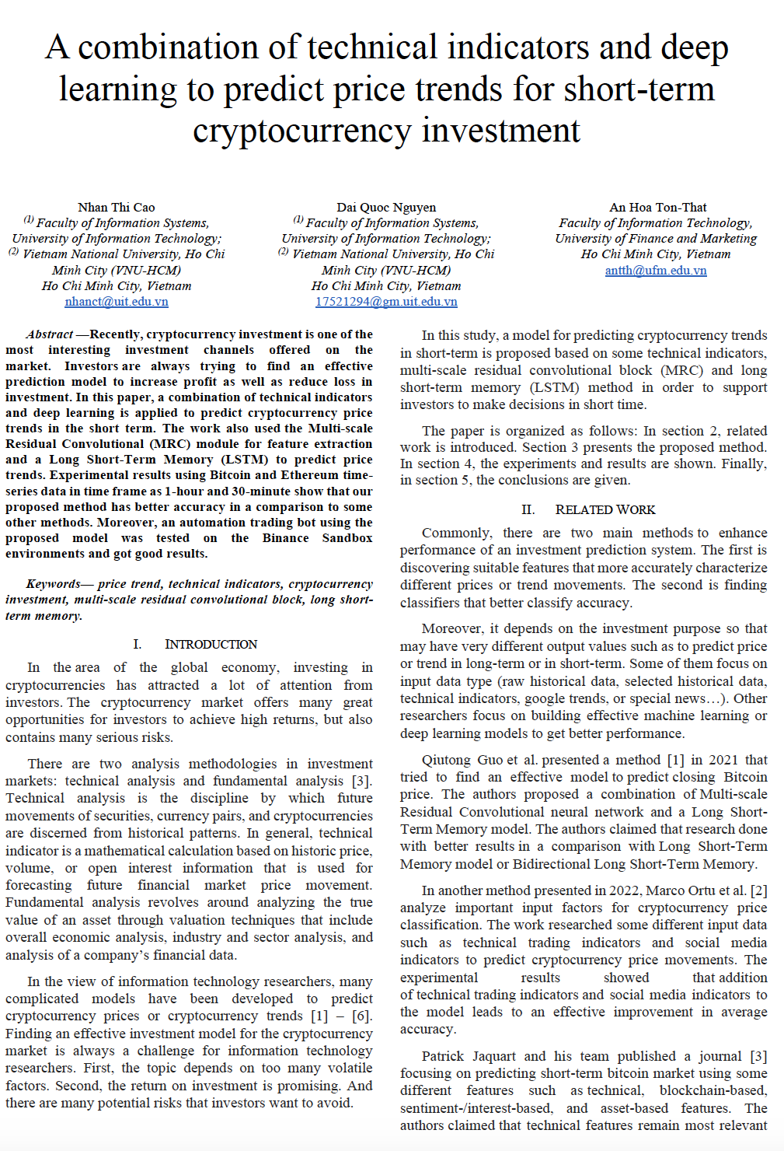

Slide 10
2) CH2: Literature Review (cont.)
Week#6 - 10/20 in Class
Each presents a published articles (In-C)
Submit Progress Report#2.1 – CH2 (In-C) (#4)
3 or more Academic Papers
Suggested steps for doing a literature review:
Find background information on your topic, only from published articles/thesis:
Skim reference sources for abstract, introduction, and conclusion
–> 1. Main Contributions/Key Findings *
–> 2. Data & Method used/proposed *
Find additional relevant published articles from bibliographies or citations of primary/secondary sources:
Find out what has been done!
Discover what appropriate methodologies used in that research/wors
Find out a need for further research/implementation <typically, stated in conclusion/future work>
–> 3. Identify research gaps/problems! *
Repeat step 1-2 until you are in a better position to understand, interpret, and analyze the previous works:
State an interpretation of your own and look for more related published works as needed.
Create more original data to confirm or refute your hypothesis
Come up with prospective methods/designs/solutions for your own work/thesis
Ref: Missy Harvey, “What Is a Literature Review?”,2010.

Slide 11
Useful sources for finding published article/references
Mahidol E-Database: https://stang.sc.mahidol.ac.th/online/ebase.php
IEEE Xplore Digital Library
ScienceDirect
Scopus
SpringerLink
Taylor & Francis Online (Informa HealthCare Journals)
etc.

Slide 12
3) CH3: Methods
Must do only after completing CH2 Literature Review
Describe what you did so that others can replicate your work
Work/System/Algorithm Design (~1 sentence)
Technical Methods used (e.g., AL/ML techniques, library, tools)
Data Collection and Preparation/Pre-Processing
Hyperparameter Configurations
Measurements/Statistical Analysis
Evaluation Approaches/Techniques used to evaluate your work performance
Statistical Tests used
Software used (name and version)

Slide 13
4) CH4: Results
Make high-level analyses and draft a summary of your results
It should answer your research problems/gaps
Construct Tables and Figures
Straightforwardly explain your results
Describes what you found
Use text to indicate the important results shown in tables and figures
Do not include interpretation or any opinions
Provide the “why” and “how” in "Discussion” section

Slide 14
5) Discussion & Conclusion (+ FutureWork)
It is a rerstatement of your results + implications
Summarize main findings and implications
Highlight the importance of main findings
Point out the implications supported by the results
State if the findings support or go against your expectations/hypotheses
Typically, end with future work

Slide 15
0) Abstract & Key Words (~5 words)
Write the abstract LAST.
An abstract is typically ~250-400 words.
Outline the hypothesis and the key conclusions of your work.
State your main points proposed/developed in your work:
Method/Design Name(s)*
Data & Evaluation (if essential or needed)
Results and Key Finding* in brief

Slide 16
Abstract (~250 words) - Guidline and Tips
Background: 2 - 4 sentences
Explain why you proposed the work, and what the main objectives are
Methods: 1 - 2 sentences
Briefly describe your design, samples, technical approaches & measurements used
Results: 1 - 2 sentences
Summarize important results - not all of your results.
Conclusion: 1-2 sentences
Highlights key findings and/or your interpretations/implications
May include the next steps for research in the future
Tip: Look at the abstracts of published papers in your field to see how abstracts are generally written.

Slide 17
Examples
A Good/Poor? Title and Abstract
Indicative of the work done and informative as to the engineering techniques and the limits of precision.
Title: “A Precise Optical Instrumentation Radar”
Abstract: This paper describes an instrumentation tracker that provides real-time positional data on high-speed cooperative targets with a precision < 1 m at ranges between 300 m and 10 km. Unambiguous range is determined by a precise digital frequency-modulationcontinuous-wave (FM-CW) ranging technique using a target-mounted beacon and a narrow laser ranging beam. This system permits measurement of target position to values much less than target dimension. Azimuth and elevation angles are read out by precision shaft angle encoders and recorded in binary form, along with range and time, on magnetic tape or directly to a real-time computer.
A Good/Poor? Title and Abstract
Merely indicative of the work done and provide few technical details.
Title: “Laser Radar for Tracking Airborne Targets,”
Abstract: An instrumentation tracker that quickly shows the position of high-speed targets with great precision is described. Range is determined by a FM-CW radar. Azimuth and elevation angles are recorded on magnetic tape or read out to a computer.

Slide 18
Assignment#1 (2 points)
Summarize how to write a good proposal/thesis in your own word (2 points)
Structure
Sections (CH1-5 and etc.)
Subsections e.g., 1.1…, 1.2…, 1.5…, 2.1…, 2.3…
Precisely describe what to do in each chapter/sections & subsections within 2-3± sentences (better cite references if needed)
Install LaTeX distributor (MikeTeX) and the editor (TextStudio) of your choice.
Report your results (screen captures) after successfully installation
Due: Sun Oct/05, before 11:59 PM

Slide 19
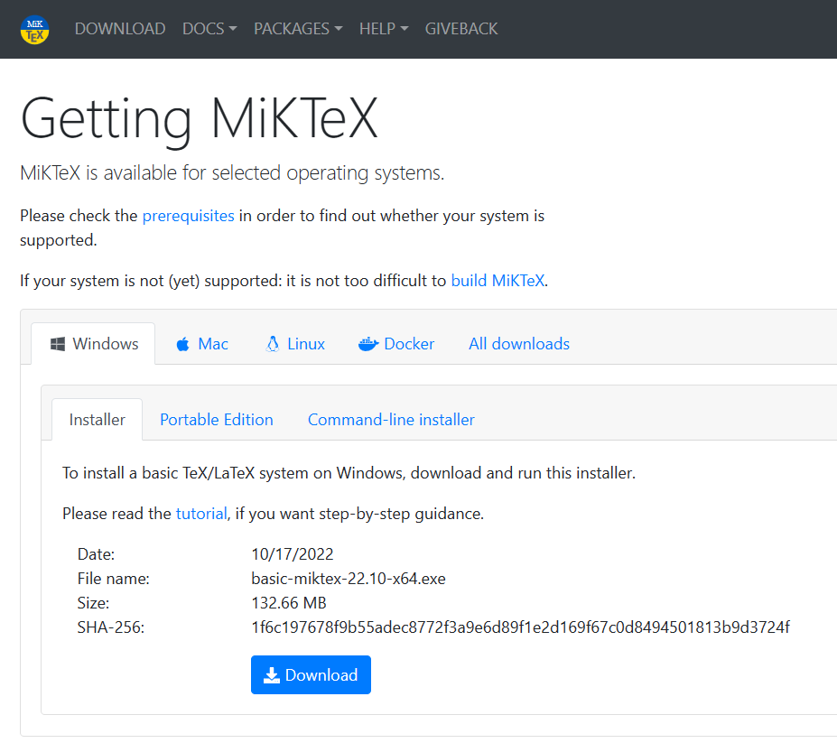
LaTeX Installation
MiKTeX editor https://miktex.org/download
(already with TeXworks installed)
Perquisites (only x64):
Windows 11, 10
MacOS 12, 11, 10.15 (Catalina)
https://miktex.org/howto/miktex-console
Ubuntu 22.04, 20.04
Linux Mint 21, 20
Debian 11, 10
Fedora 37, 36, 35
OpenSUSE Leap 15

Slide 20
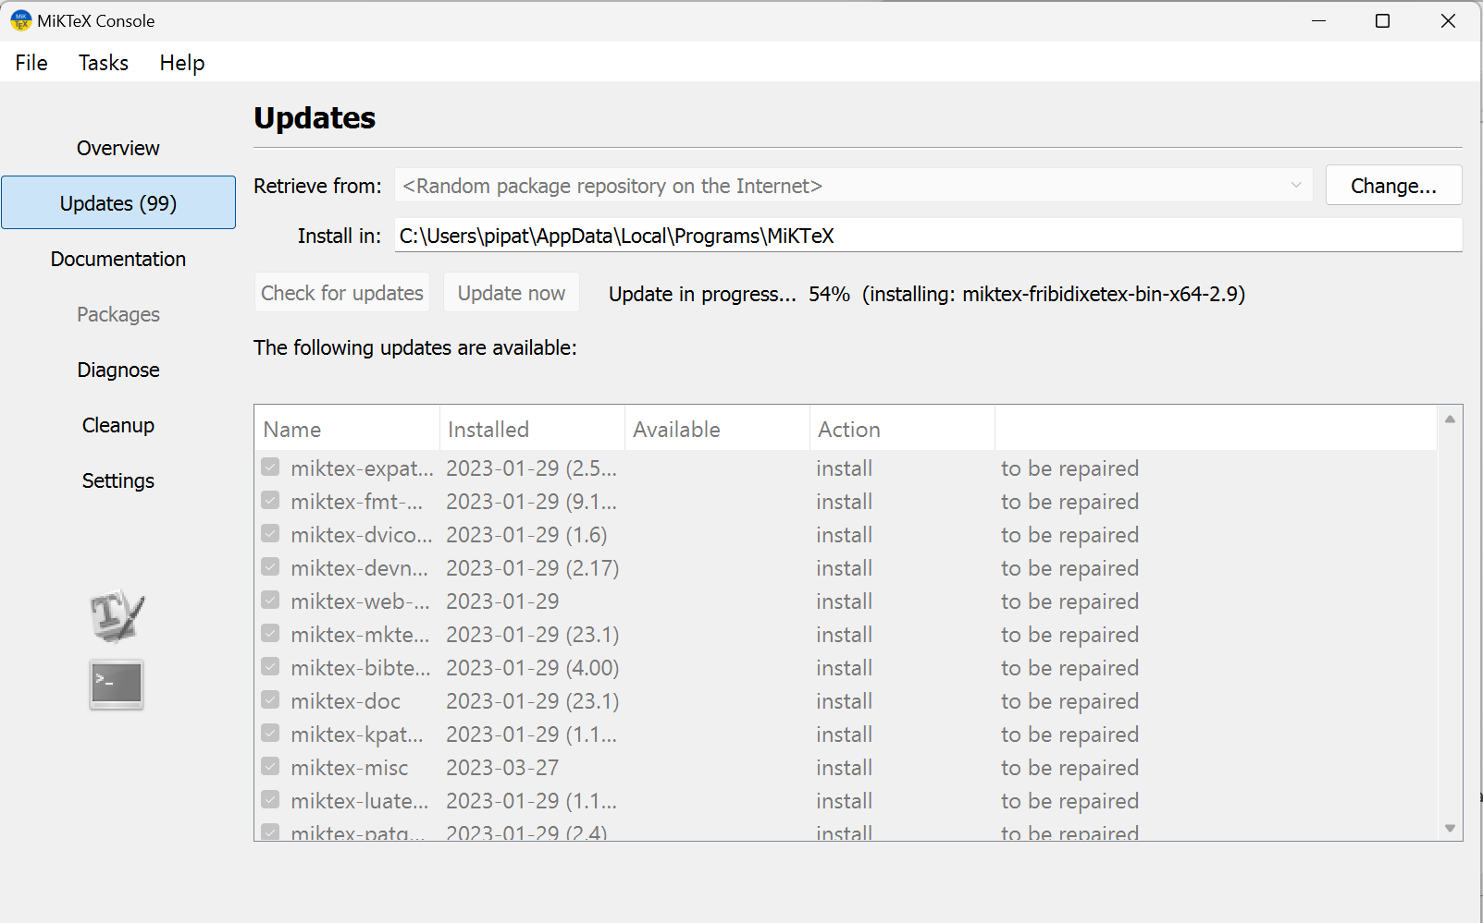
Update Packages (if required)

Slide 21
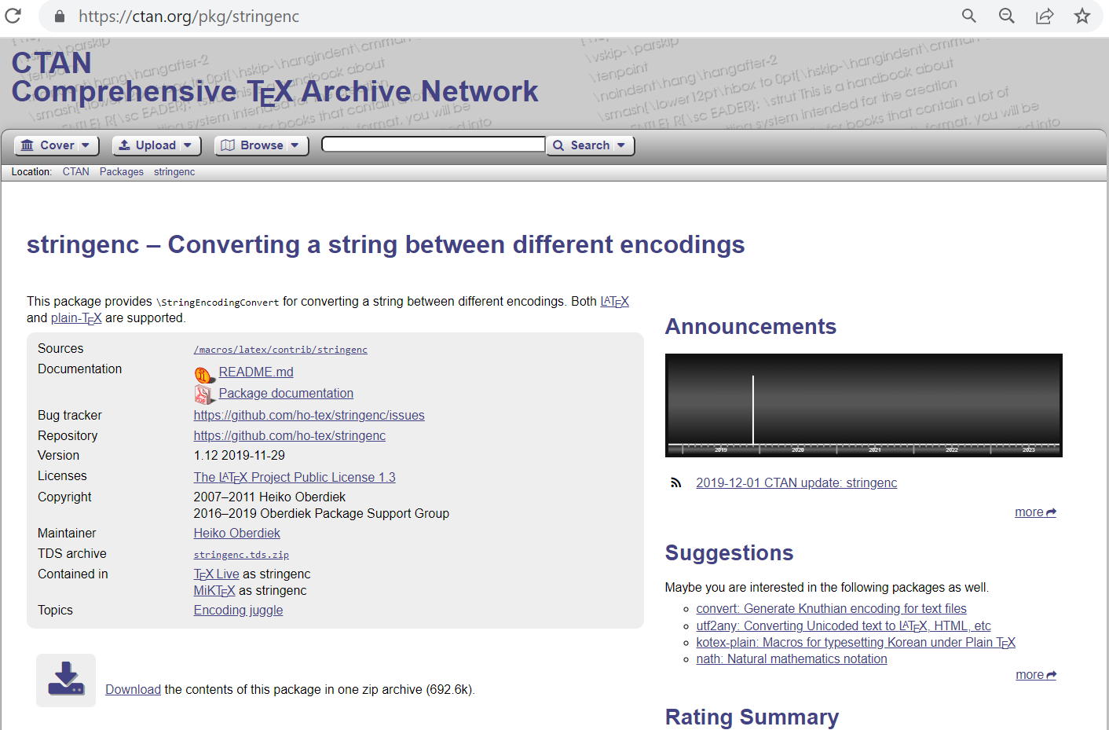
Download additional packages
CTAN: https://ctan.org/
“stringenc” may be required when using UTF8 or hyperref packages

Slide 22
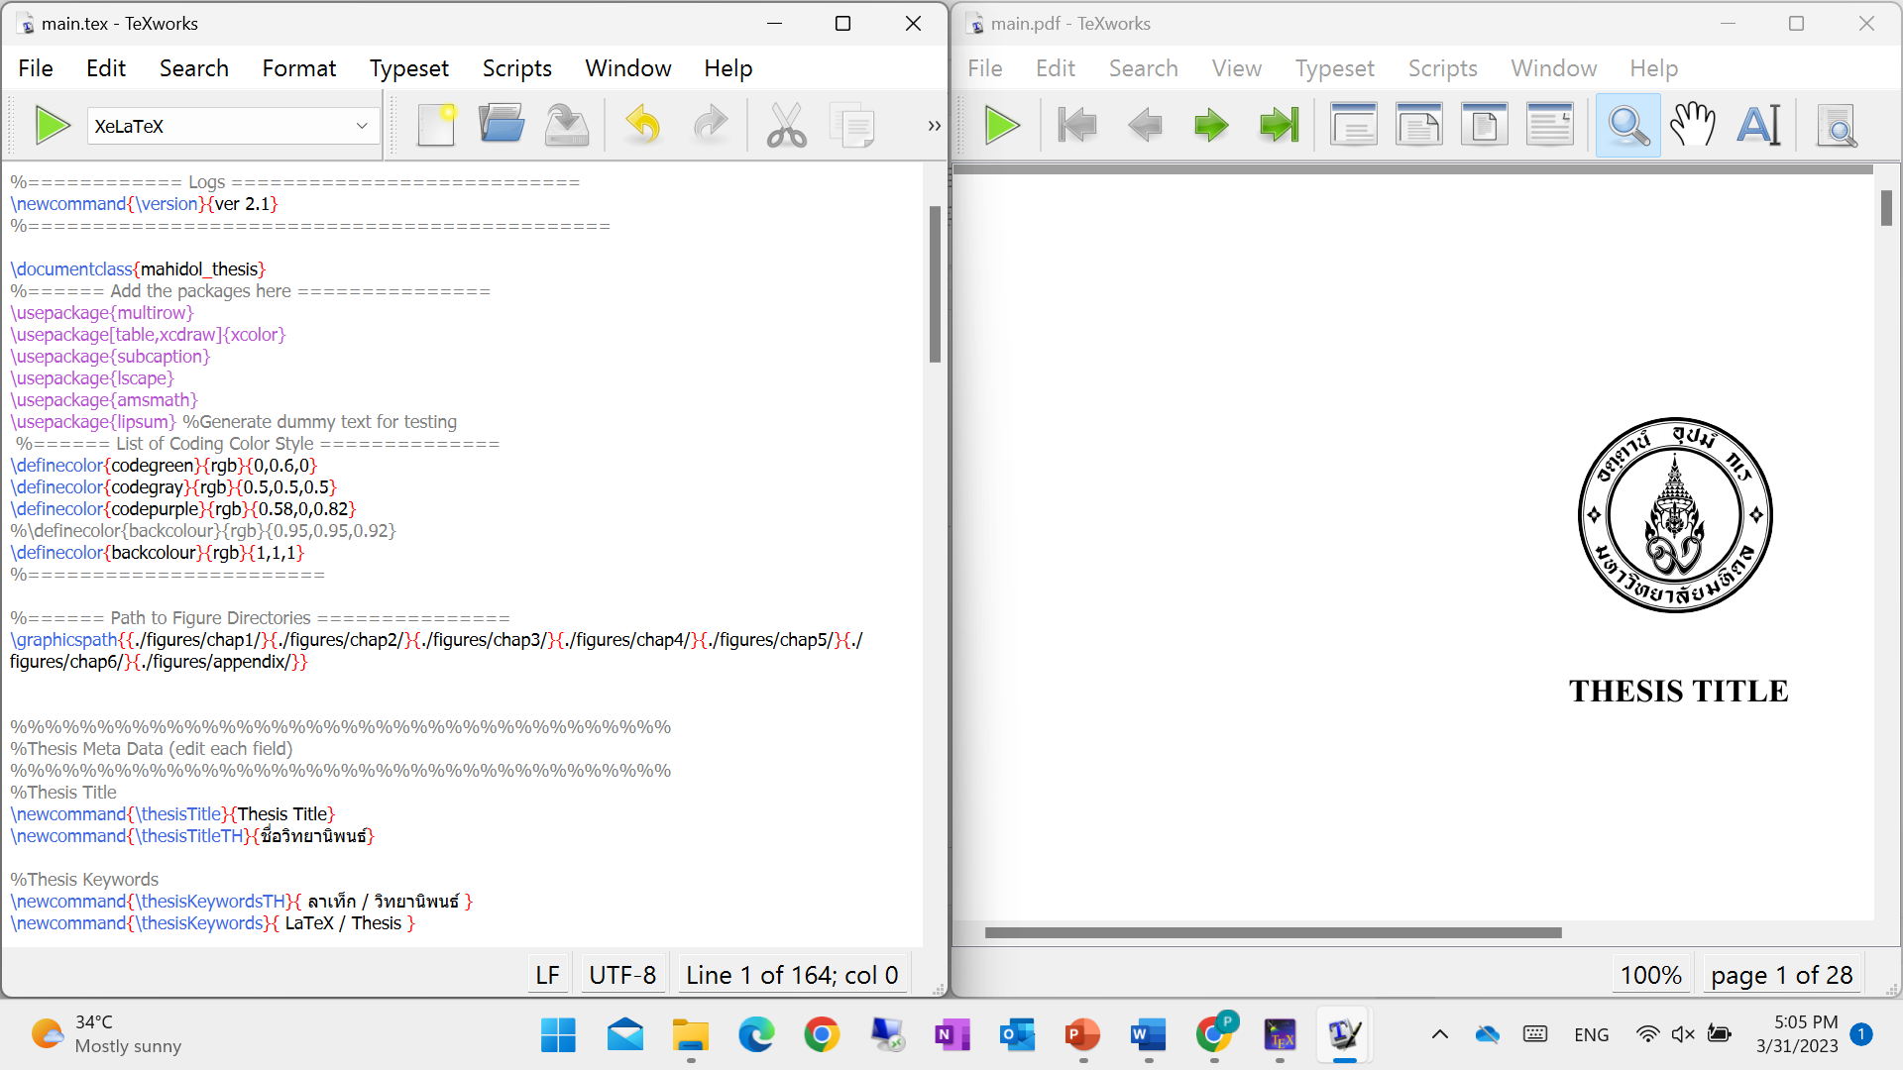
TeXworks

Slide 23
LaTeX Editors
There are many LaTeX editors, from small and quick to very feature-rich editors.
The TeX distributions (e.g., MikTex) already provide the fine editor TeXworks.
Download: https://www.tug.org/texworks/
Alternatives
TeXStudio: https://www.texstudio.org/
TexMaker: https://www.xm1math.net/texmaker/

Slide 24
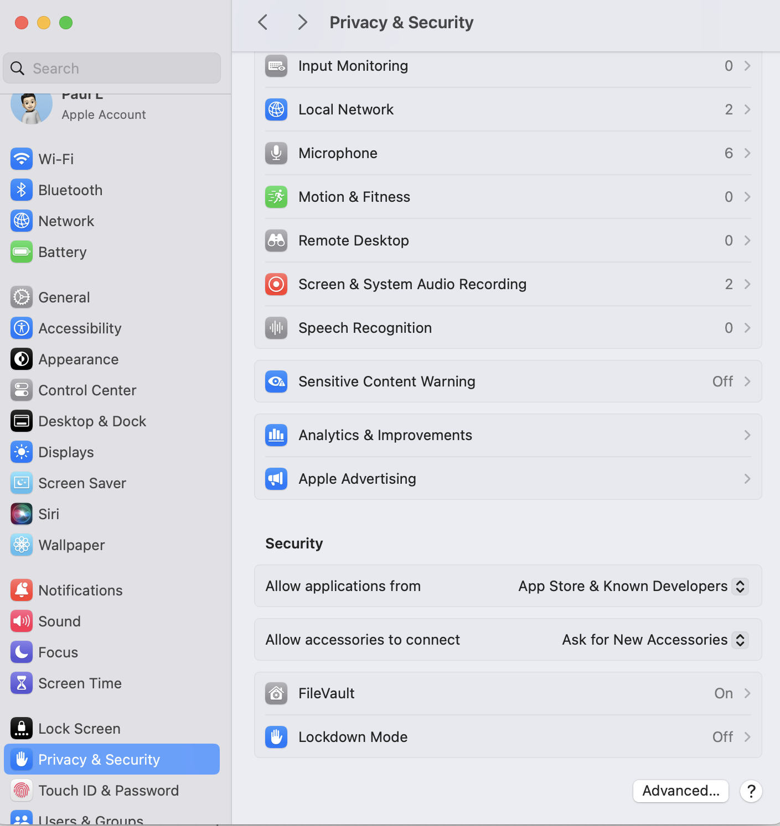

Slide 25
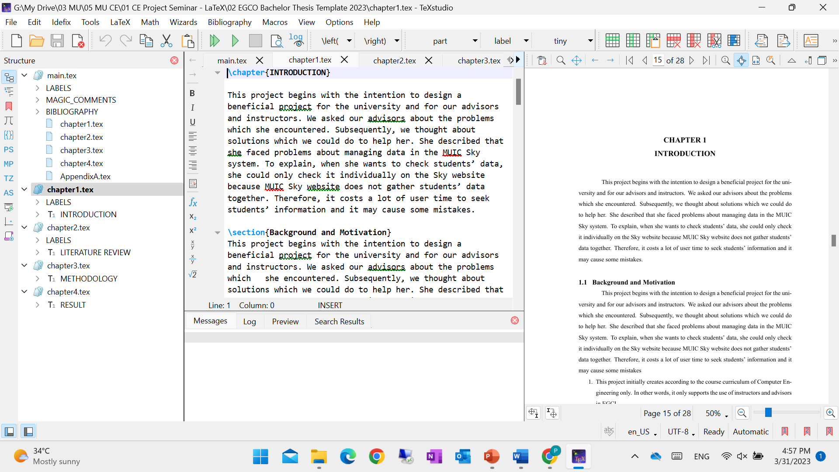
TeXstudio

Slide 26
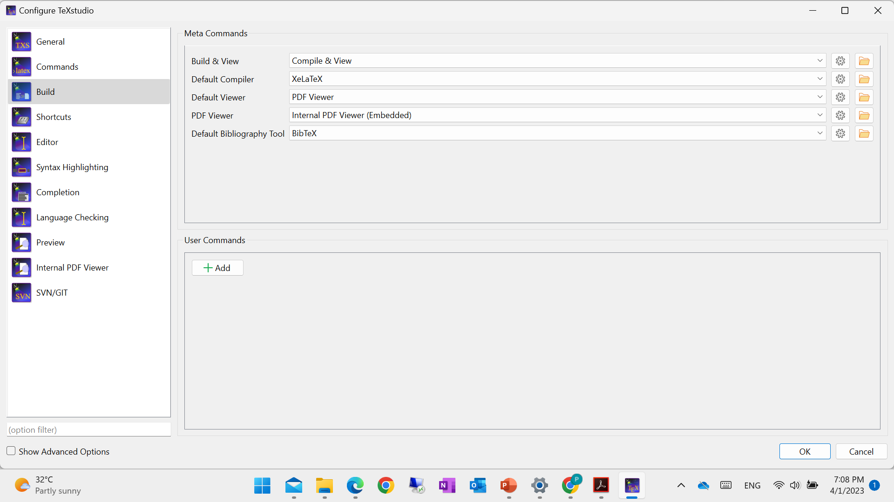
TeXstudio – Change a default complier if required

Slide 27
END

